Slide 1
Synchronized School Database System
By Ibra Cisse

Slide 2
Introduction
It is a database project to replicate a fully functional school system
The replicated school system would allow students to:
Sign up for classes
View their grades
Teachers to teach classes and assign student Grades
Principal to review the entire school’s information

Slide 3
Database and Structure
By using MySQL, a complete replication of the School system was possible with several type of users and entities along with attributes.
There are three types of Users:
Principal, Student, and Teachers
Principals: They have the most authority as to change most of the information possible such as enrolling them to different courses, viewing students entire record, etc.... However, they can not change the students grades.

Slide 4
Database and Structure
The next user that has the most privilege beside the principal is the teachers.
Teachers has the ability to add students in classes, they can add grades to students records, they can change student grades, and also they can drop a student from classes. However, they cannot add a student to a class.
Teachers also have a limitation such: each teacher can teach up to 3 classes.

Slide 5
Database and Structure
Last, but not least, are the students.
They have the ability to sign up for courses.
Each student can take up to 5 classes the most.
Beyond that boundary, they will not be able to add anymore class.
Student can view grades and such.

Slide 6
Database Structure
The structure is constructed by using 6 different entities.
They each have main attributes such as IDs which are used as primary keys
The remaining of the attributes are use to hold information such as first name, last name, username and password and so forth.
Most Entities of the database certain link that the database schema shows in its diagram.

Slide 7
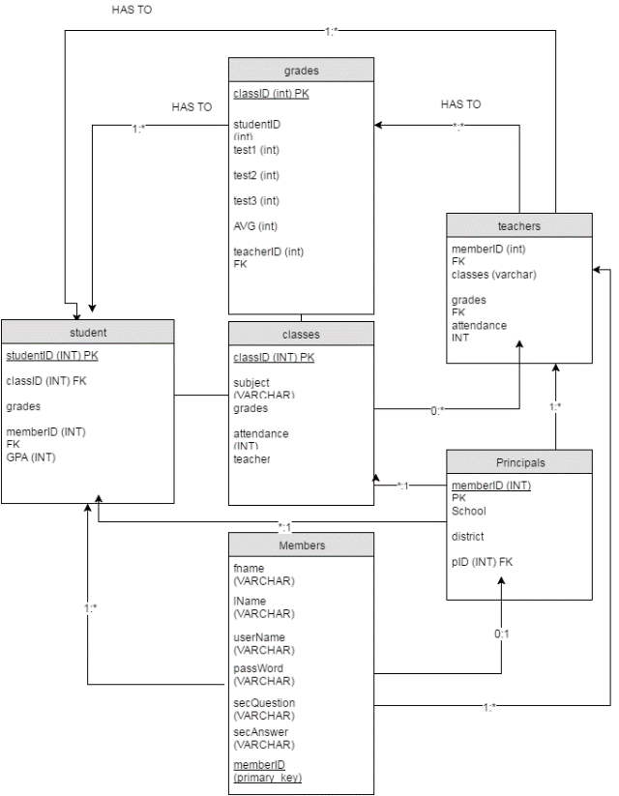
Database Diagram

Slide 9
Database scenarios and Use Cases
There are multiple use cases from student signing up for classes to principals determining the number student having averages higher than a certain number.
Few of the type of use cases that the presentation will cover will be:

